Slide 1

TOWARD A MULTIFACTORIAL MODEL OF EXPERTISE
Zach Hambrick, Michigan State University
Versions of this presentation given at:
Karolinska Institute
Edith Cowan University
Francis Marion University
Boston College
University of Notre Dame
Western Sydney University
University of Western Australia
PLEASE FEEL FREE TO USE ANY OF THE SLIDES IN
THIS PRESENTATION, WITH ACKNOWLEDGEMENT.

Slide 2

VARIABILITY IN COMPLEX SKILL

Slide 3
VARIABILITY IN COMPLEX SKILL
“Expert”
“Elite”

Slide 4
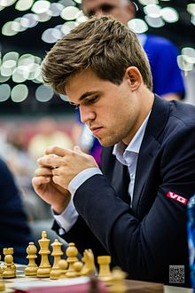
VARIABILITY IN COMPLEX SKILL
- Learned moves of chess at 5
- Took up game seriously at 8
- Grandmaster at 13
- FIDE World No. 1 at 19
- Highest rating in history at 24
October 2017: World No. 1 in classical, rapid, and blitz chess

Slide 5
THE SCIENCE OF EXPERTISE
?
What factors explain this striking variability?

Slide 6
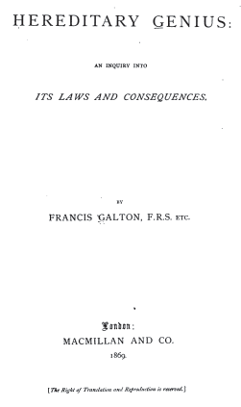
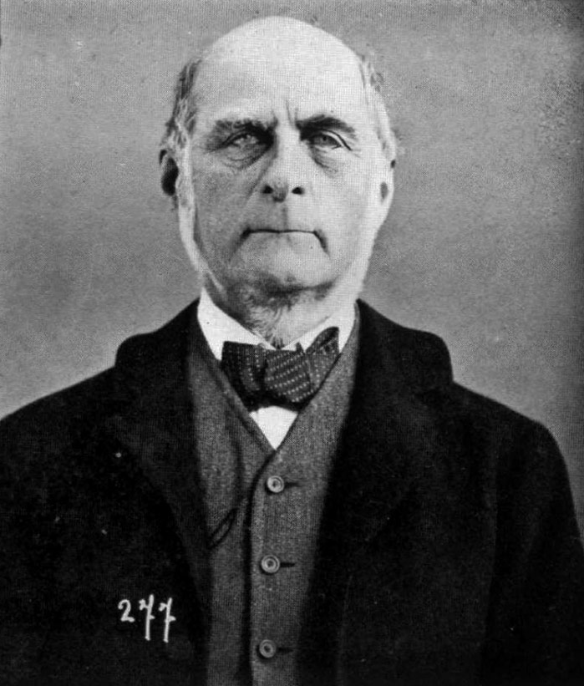
EXPERTS ARE “BORN”

Slide 7
EXPERTS ARE “BORN”
I HAVE no patience with the hypothesis occasionally expressed, and often implied, especially in tales written to teach children to be good, that babies are born pretty much alike, and that the sole agencies in creating differences between boy and boy, and man and man, are steady application and moral effort.”
- Francis Galton (1869)
“

Slide 8
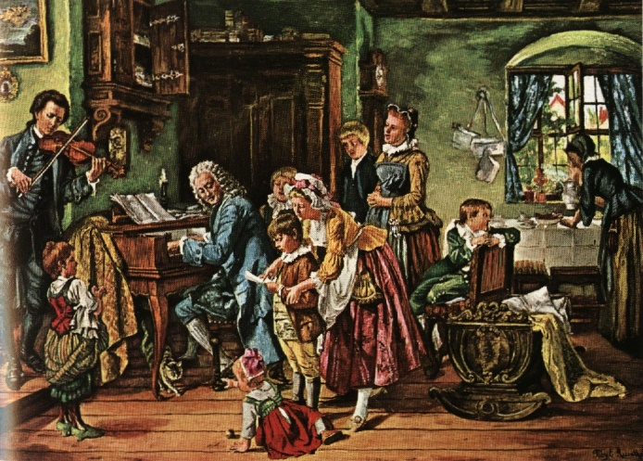
EXPERTS ARE “BORN”
“

Slide 9
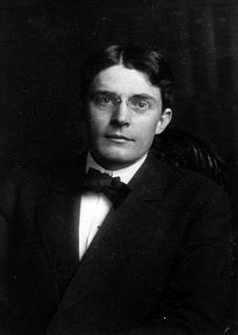
EXPERTS ARE “MADE”
Give me a dozen healthy infants, well-formed, and my own specified world to bring them up in and I'll guarantee to take any one at random and train him to become any type of specialist I might select - doctor, lawyer, artist, merchant-chief and, yes, even beggar-man and thief, regardless of his talents, penchants, tendencies, abilities, vocations…”
- John Watson (1930)
“

Slide 10

DELIBERATE PRACTICE VIEW
We agree that expert performance is qualitatively different from normal performance and even that expert performers have characteristics and abilities that are qualitatively different from or at least outside the range of those of normal adults. However, we deny that these differences are immutable, that is, due to innate talent. Only a few exceptions, most notably height, are genetically prescribed.”
- Ericsson, Krampe, & Tesch-Romer (1993)
“
K. Anders Ericsson

Slide 11
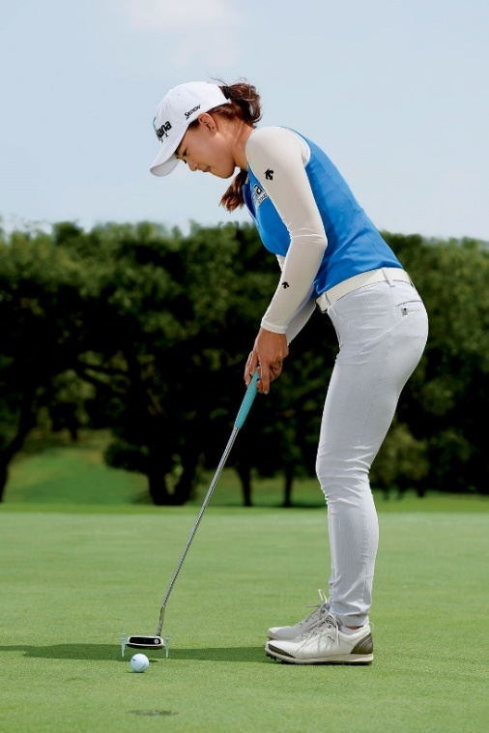
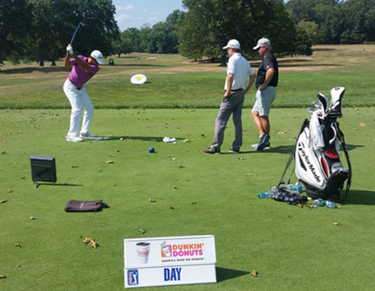
DELIBERATE PRACTICE VIEW
“
Jason Day (World #10)
Minjee Lee (World #16)
“Deliberate Practice”

Slide 12
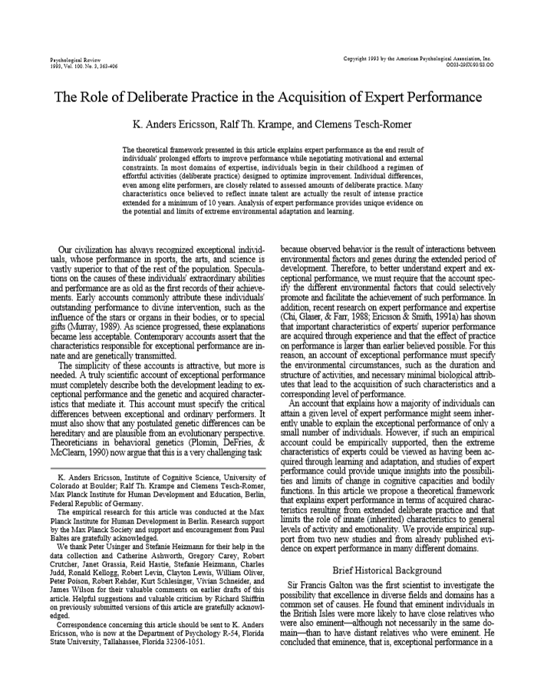
DELIBERATE PRACTICE VIEW
Ericsson, Krampe, & Tesch-Römer (1993)—one of the most cited articles in the psychological literature…
~ 10k hrs
8,183 Citations as of 3/26/2018
Ericsson (2006), Figure 38.4

Slide 13
DELIBERATE PRACTICE VIEW
“
[I]ndividual differences in ultimate performance can largely be accounted for by differential amounts of past and current levels of practice.”
− Ericsson et al. (1993)
This article argues that it is possible to account for the development of elite performance among healthy children without recourse to unique talent (genetic endowment) — excepting the innate determinants of body size. This account based on the expert-performance approach shows that the distinctive characteristics of elite performers are adaptations to extended and intense practice activities that selectively activate dormant genes that all healthy children's DNA contain.”
− Ericsson (2007), International Journal of Sport Psychology
“

Slide 14

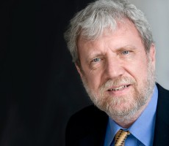

IN POPULAR CULTURE
We actually find that with the right kind of training any individual will be able to acquire abilities that were previously viewed as only attainable if you had the right kind of genetic talent.”
− K. Anders Ericsson
Freakonomics Radio, April 27, 2016
“

Slide 15
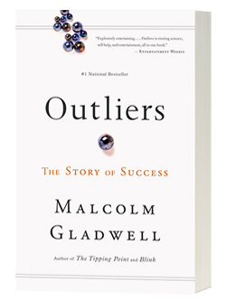
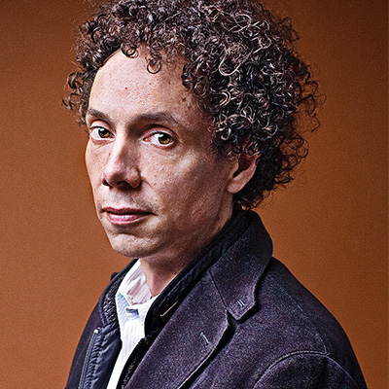
IN POPULAR CULTURE
“
Gladwell’s “10,000 Hour Rule”

Slide 16
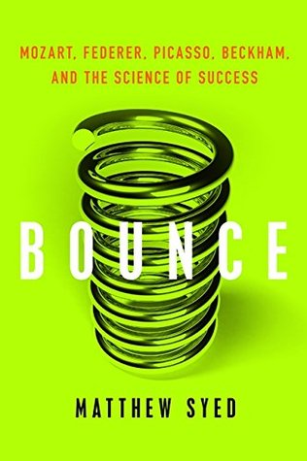
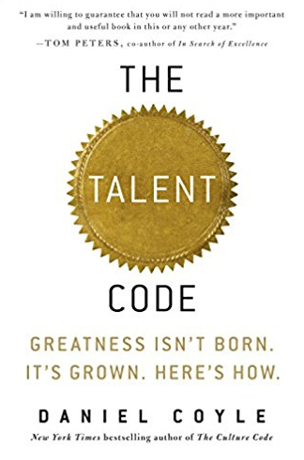
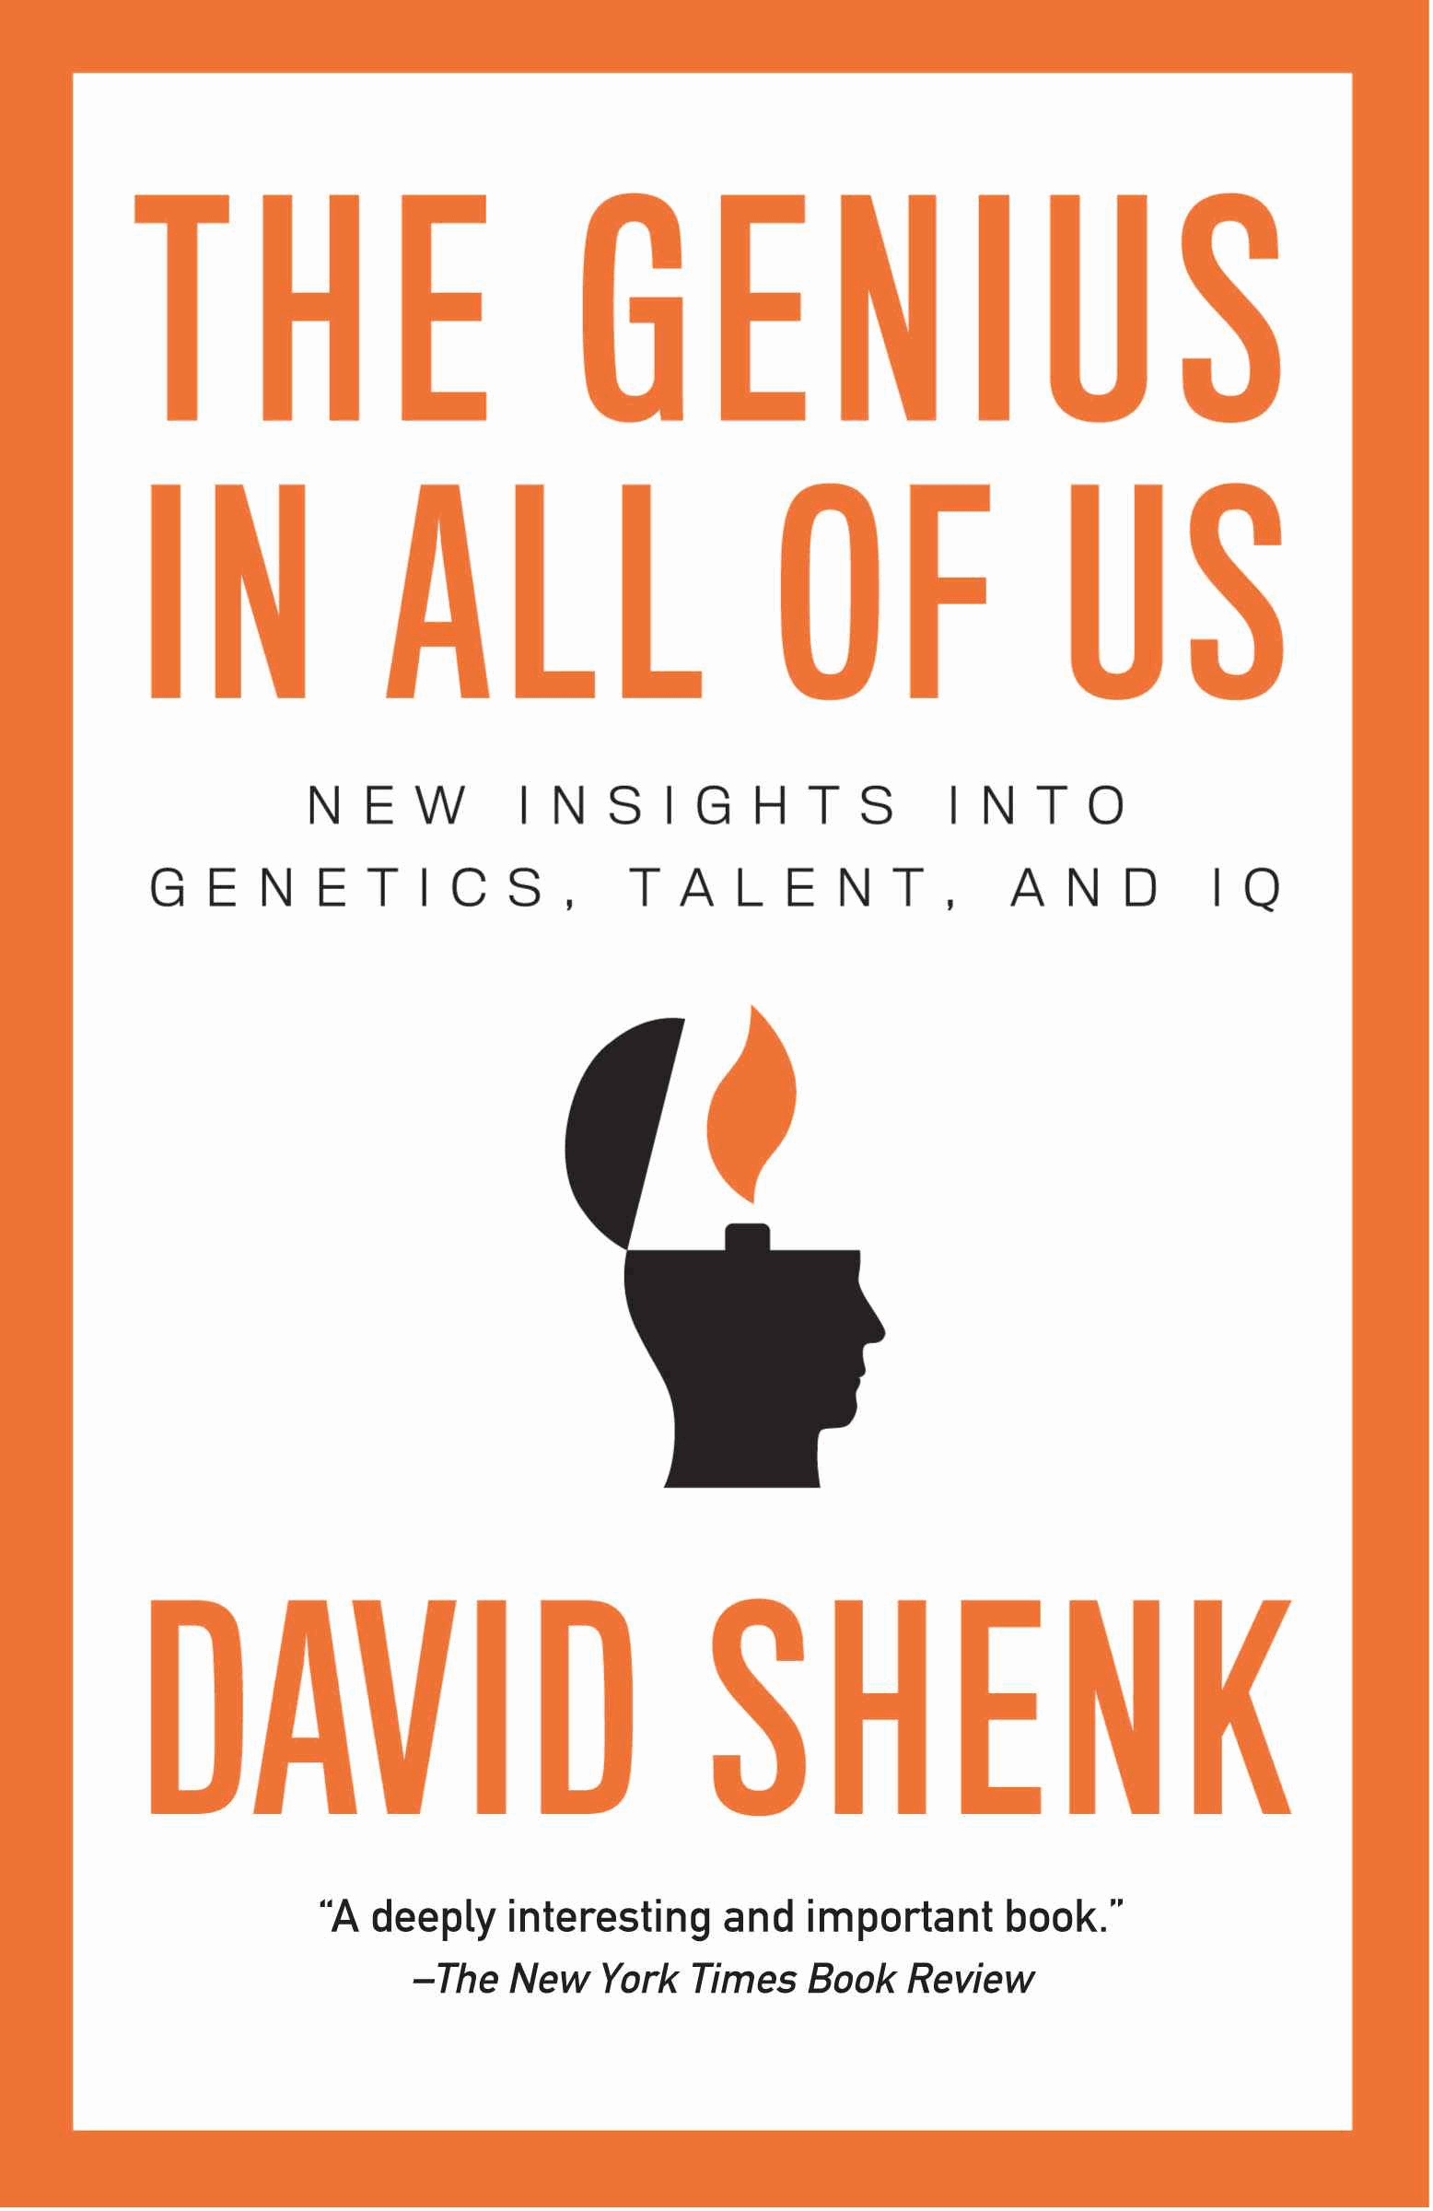
IN POPULAR CULTURE
Other books that have featured findings from Ericsson and colleagues’ research…

Slide 17

IN POPULAR CULTURE
Ten thousand hours felt like ten thousand hands /
Ten thousand hands, they carry me /
Ten thousand hours felt like ten thousand hands /
Ten thousand hands, they carry me
Macklemore (right) and Ryan Lewis

Slide 18

IN POPULAR CULTURE

Slide 19
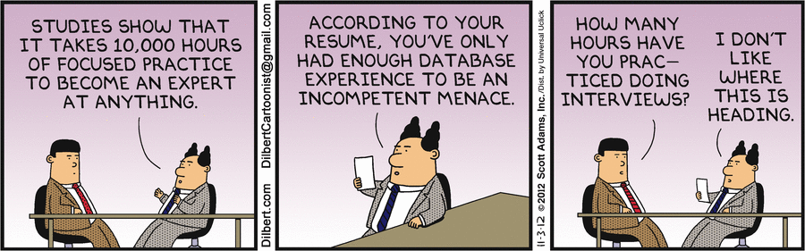
IN POPULAR CULTURE

Slide 20
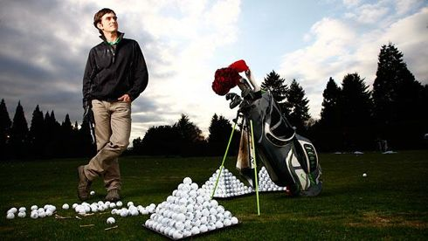
IN POPULAR CULTURE
Dan McLaughlin – “The Dan Plan”
After reading Outliers and The Talent Code, quit day job with goal of making it to PGA Tour through deliberate practice. Consulted with Anders Ericsson on plan.

Slide 21
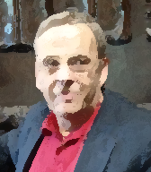

CONTROVERSIAL FROM START
Detterman: Are you saying that with the prescribed amount of practice I or anyone else can become as expert as the people you are studying?
Ericsson: Yes, if you have the prerequisite motivation, and are willing to invest the energy.
From Can we create gifted people, CIBA Foundation symposium, 1993

Slide 22
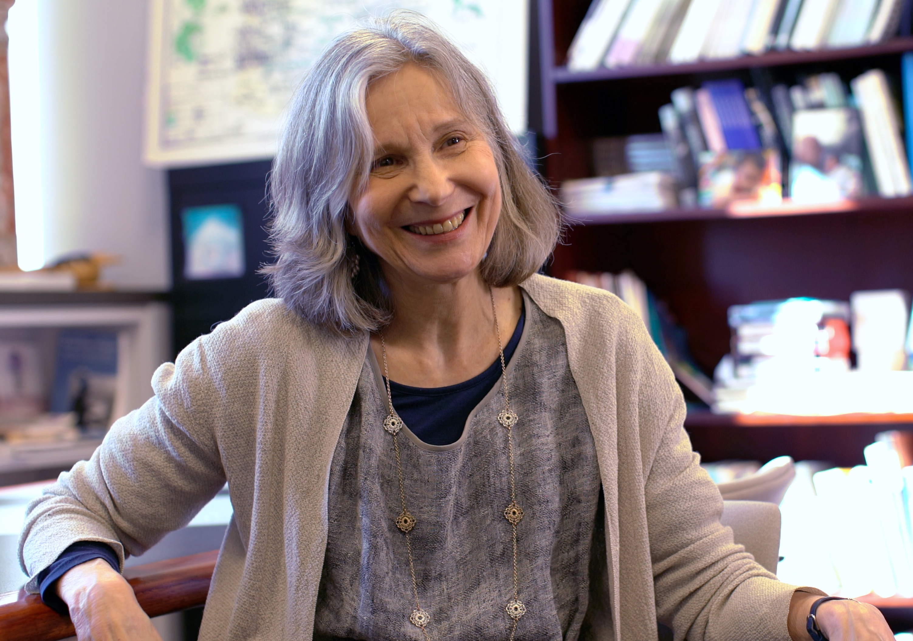
CONTROVERSIAL FROM START
“
[This] evidence…although clearly demonstrating the role of motivation, commitment, and hard work, fails to rule out the possibility that innate talent plays a necessary role in high achievement.”
- Ellen Winner (1996)

Slide 23
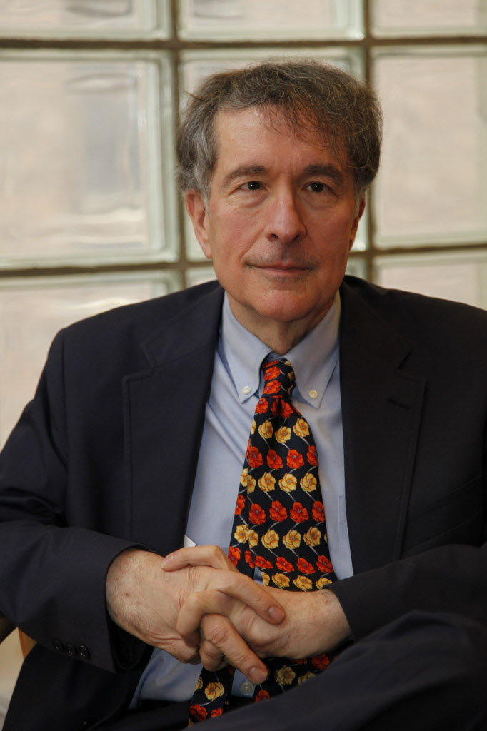
CONTROVERSIAL FROM START
“
[I]t requires a blindness to ordinary experience—as well as to decades of psychological theorizing…to deny that a major variable operating on most individuals is their own success at a particular pursuit.”
- Howard Gardner (1995)

Slide 24

CONTROVERSIAL FROM START
Ericsson's claims should be taken with great reluctance, because they may have highly disappointing results for parents and others who have great hopes, but no data on which to base such hopes.”
- Philip Ackerman (2014)
“

Slide 25
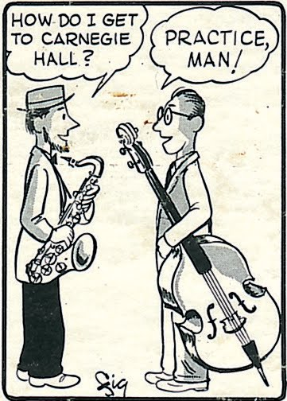
WHAT IS NOT CONTROVERSIAL
Training is necessary to acquire expertise
Which is to say…

Slide 26
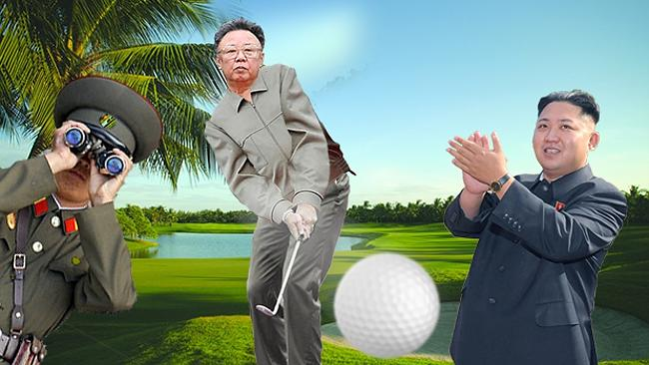
WHAT IS NOT CONTROVERSIAL
North Korean government report: Kim Jong-il shot world-record demolishing 38-under par his first time playing golf, with 5 holes-in-one (11 by some reports).
Experts aren’t literally born.

Slide 27
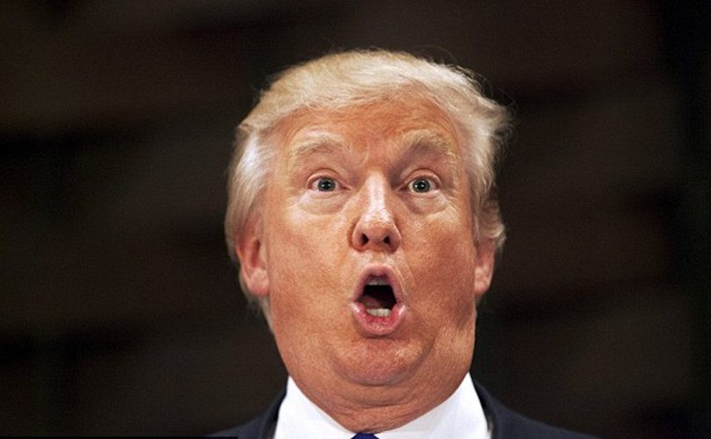
WHAT IS NOT CONTROVERSIAL
“I know more about ISIS than the generals. Believe me.”
- Donald J. Trump, Former Reality TV Star & U.S. President
Experts aren’t literally born.

Slide 28

WHAT IS NOT CONTROVERSIAL
Experts aren’t literally born.

Slide 29
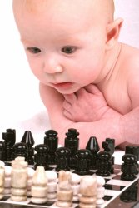
WHAT IS NOT CONTROVERSIAL
If you doubt this proposition, challenge any baby to a game of chess. If you know the rules you will not lose.
Experts aren’t literally born.

Slide 30
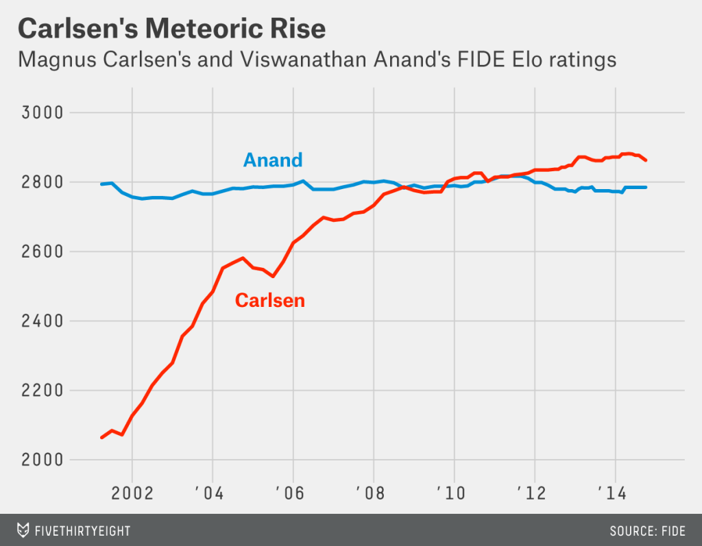
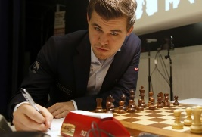
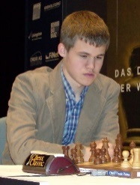
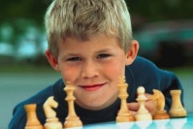
WHAT IS NOT CONTROVERSIAL
Within-person variability

Slide 31

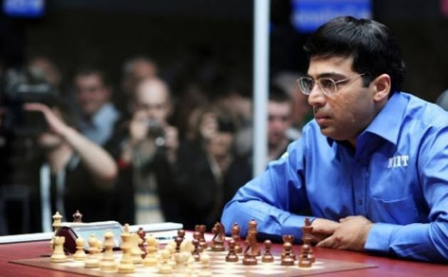
WHAT IS CONTROVERSIAL
Between-person variability

Slide 32
WHAT IS CONTROVERSIAL
W = Within-person B = Between-person
r_{W}s Positive
r_{B} Positive
r_{W}s Positive
r_{B} Negative
A
A
Performance
B
Performance
B
C
C
0 100 1000 10000
Training Hrs.
0 100 1000 10000
Training Hrs.
The necessity of training to account for increases in performance within individuals has no direct implication for the magnitude and direction of the correlation of training with performance between individuals.

Slide 33
TESTING ERICSSON’S VIEW
Testable Claim: “individual differences in ultimate performance can largely be accounted for by differential amounts of past and current levels of practice” (Ericsson et al., 1993).

Slide 34
TESTING ERICSSON’S VIEW
Major inclusion criterion: Measures of one or more activities interpretable as deliberate practice and of performance were collected.

Slide 35
TESTING ERICSSON’S VIEW
Approach: Compute the average correlation, correcting for unreliability of the measures, and the average amount of variance explained.

Slide 36
TESTING ERICSSON’S VIEW
Chess
6 studies
Hambrick et al. (2014), Intelligence

Slide 37
TESTING ERICSSON’S VIEW
Music
8 studies
Hambrick et al. (2014), Intelligence

Slide 38
TESTING ERICSSON’S VIEW
Music
14 studies (including some we missed!)
Platz, Kopiez, Lehmann, and Wolf (2014), Frontiers in Psychology

Slide 39
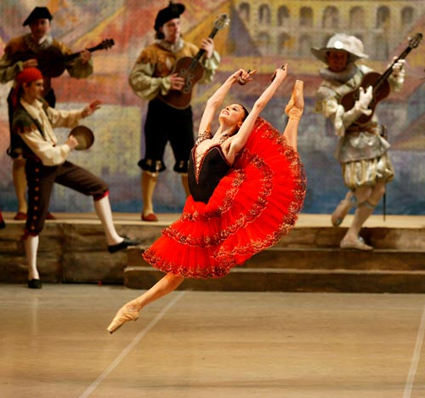
TESTING ERICSSON’S VIEW
Hutchinson, Sachs-Ericsson, and Ericsson (2014) −
Bolshoi Ballet
National Ballet of Mexico
Boston Ballet
Dance Theater of Harlem
Cleveland Ballet
Range of expertise: Principal in international company, to no professional position
N = 49
Svetlana Zakharova in Kitri Variation with the Bolshoi Ballet

Slide 40
TESTING ERICSSON’S VIEW
Ballet
Age 18: practice aimed at improving technique and attained level of expertise.
r = .50
Hutchinson, Sachs-Ericsson, & Ericsson (2014), High Ability Studies

Slide 41
TESTING ERICSSON’S VIEW
Ericsson and colleagues: “It has been common for scientists to be confused about the definition of DP.”*
*Dearani, Gold, Leibovich, Ericsson, et al. (2018). J. of Thoracic and Cardiovascular Surgery.

Slide 42
TESTING ERICSSON’S VIEW
Ericsson and colleagues: “It has been common for scientists to be confused about the definition of DP.”*
It sure has!
*Dearani, Gold, Leibovich, Ericsson, et al. (2018). J. of Thoracic and Cardiovascular Surgery.

Slide 43
TESTING ERICSSON’S VIEW
Ericsson and colleagues: “It has been common for scientists to be confused about the definition of DP.”*
Here’s why…
*Dearani, Gold, Leibovich, Ericsson, et al. (2018). J. of Thoracic and Cardiovascular Surgery.

Slide 44
TESTING ERICSSON’S VIEW
Ericsson has defined DP in different ways, e.g.,
Deliberate practice must involve a teacher:
“In distinction from leisurely or normal job-related experience, Ericsson et al. defined deliberate practice as a very specific activity designed for an individual by a skilled teacher explicitly to improve performance.” (Krampe & Ericsson, 1996, p. 333)
Deliberate practice typically involves a teacher:
“When individuals engage in a practice activity (typically designed by their teachers), with full concentration on improving some aspect of their performance, we call that activity deliberate practice.” (Ericsson, 2007, p. 14)
Deliberate practice need not involve a teacher:
“Ericsson et al. (1993) proposed the term deliberate practice to refer to those training activities that were designed solely for the purpose of improving individuals’ performance by a teacher or the performers themselves.” (Ericsson, 1998, p. 84)
How could a scientist NOT be confused about the definition of DP?

Slide 45

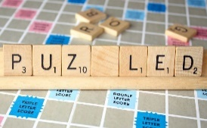
TESTING ERICSSON’S VIEW
2009: There are activities that meet the “criteria of deliberate practice” in SCRABBLE…
“Several researchers have reported a consistent association between the amount and quality of solitary activities meeting the criteria of deliberate practice and performance in different domains of expertise, such as…Scrabble” (p. 9).
- Ericsson et al. (2009)
2017: SCRABBLE players “cannot engage in deliberate practice”…
“[T]he domain of SCRABBLE is a recently developed domain, and it lacks professional coaches and a large body of written knowledge about training. SCRABBLE players, therefore, must decide for themselves which types of training activities that they think are effective for improving their performance. Consequently, SCRABBLE players cannot engage in deliberate practice, but only purposeful practice and other types of practice” (p. 4).
- Moxley, Ericsson, & Tuffiash (2017)
How could a scientist NOT be confused about the definition of DP?

Slide 46
THE BOTTOM-LINE
What the evidence tells us: Deliberate practice is important as a predictor of individual differences in expertise, from a statistical, practical, and theoretical perspective. It’s just not as important as Ericsson has argued it is.

Slide 47
WHAT DOES ALL OF THIS MEAN?
Barring disability, there is no reason to think that a person will not benefit from deliberate practice, but people vary widely in the amount of deliberate practice it takes them to reach a given level of skill.

Slide 48

WHAT DOES ALL OF THIS MEAN?
2007 Chess Study—
90 chess players recruited from Buenos Aries chess club
Completed survey to assess amount of deliberate practice
Massive variability in amount of deliberate practice to reach a given skill level.
Guillermo Campitelli

Slide 49
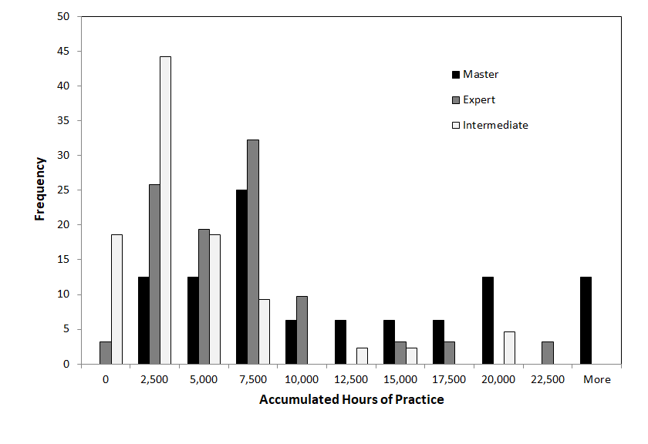
WHAT DOES ALL OF THIS MEAN?
Large amount of variability within skill level. Some never reached master level, despite > 25k hours of DP.
Gobet & Campitelli (2007); Campitelli & Gobet (2008)

Slide 50
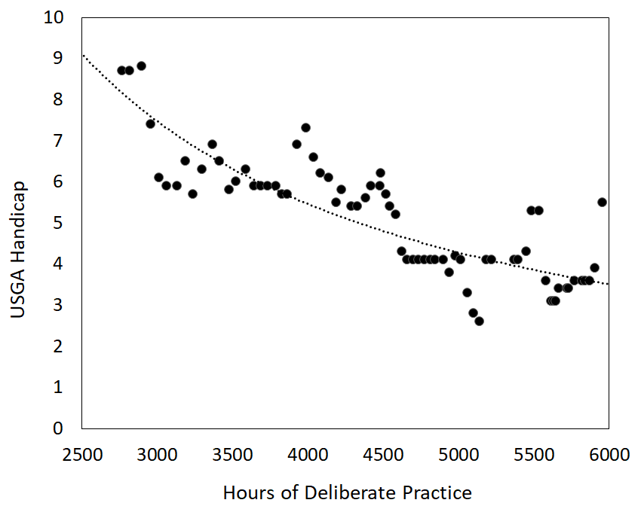
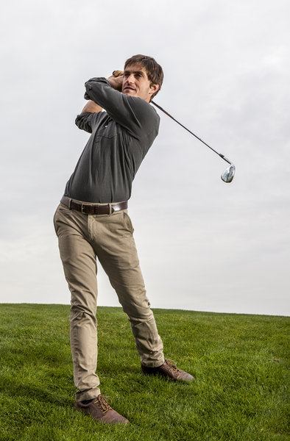
WHAT DOES ALL OF THIS MEAN?
In just over 5 years, Dan becomes a good recreational player,
though struggles in tournament play.
+21 (84/81) in Iceberg Open
+25 (87/80) in Oregon Mid-Am
+47 (88/87/88) in Royal Oaks Inv’l
+3 (75) in Riverside Masters
-2 (70) in non-tournament (career low)
Injury

Slide 51
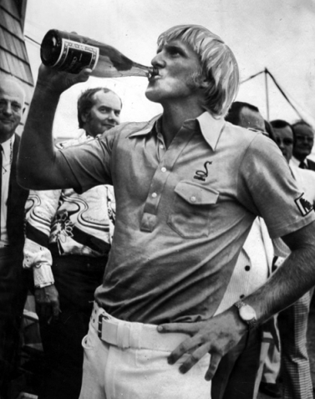
WHAT DOES ALL OF THIS MEAN?
What Greg Norman accomplished in 5 years…
Age 15: gets first set of golf clubs, records first score of 108.
Age 17: reaches a scratch (zero handicap) about 18 months after beginning
Age 18: second-low amateur in Australian Open (+7 for 4 days).
Age 21: Turns pro; with -13 total, wins first professional tournament, in Adelaide, beating two of best players in world.
At age 32, reaches World No. 1; holds spot for total of 332 non-consecutive weeks.

Slide 53
One piece
of a complex
puzzle

Slide 54

OTHER PIECES OF PUZZLE
1
Developmental factors
2
Ability factors
3
Dispositional factors
4
Genetic factors
5
Task/situational factors

Slide 55
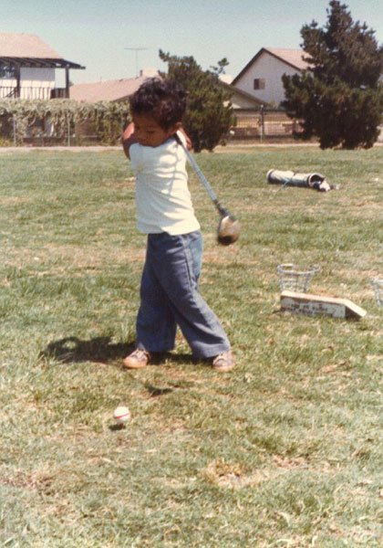
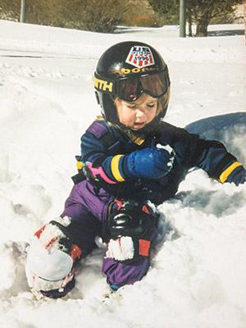
DEVELOPMENTAL FACTORS
Starting age: When is the optimal age to specialize?

Slide 56
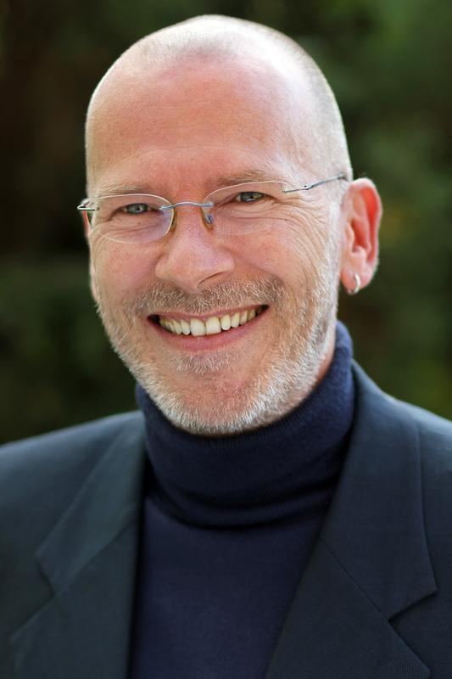
DEVELOPMENTAL FACTORS
Study of Elite Athletes
83 medalists, 83 non-medalists matched on sport, age, and gender
Completed survey to assess practice history, starting age
Medalists specialized later (M = 11.8 years) than non-medalists (M = 10.3 years).
Prof. Arne Güllich, Technische Universität Kaiserslautern

Slide 57
d = .11
Specializing early may not be the way to go…
d = .15
d = .30
**
Estimated Accumulated Main Sport Practice/Training (Number of Hours)
d = .34
*
Non-medalist
Medalist
d = .38
**
Age Range

Slide 58

ABILITY FACTORS

Slide 59
ABILITY FACTORS
Extraordinary talent
High talent
Performance
Average talent
Low talent
Practice

Slide 60
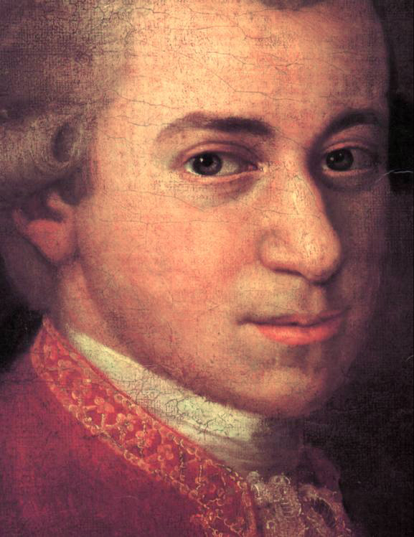
ABILITY FACTORS
Prodigy – a child who performs at a level well above same-age peers.

Slide 61
ABILITY FACTORS
Nadia
5 – 6 years
5 years, 6 months

Slide 62
ABILITY FACTORS
6 years

Slide 63
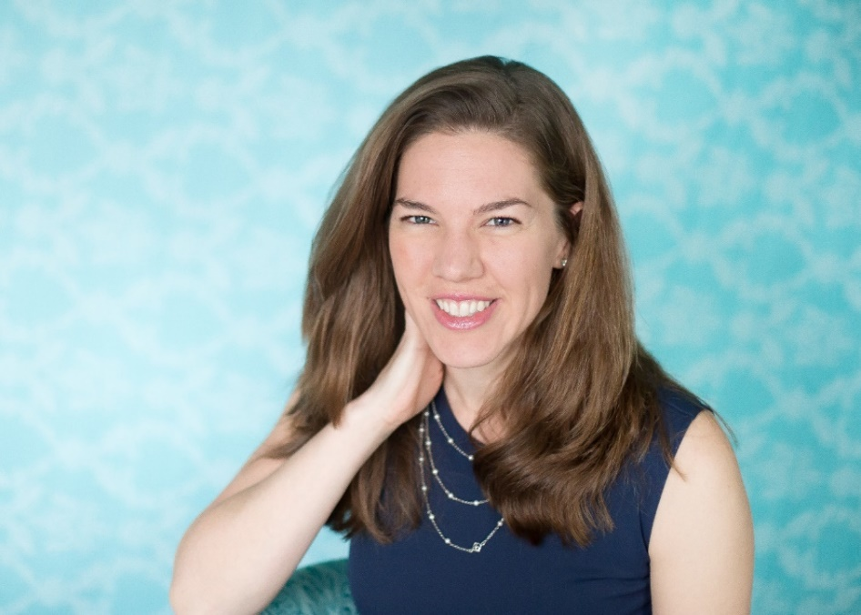
ABILITY FACTORS
18 prodigies
- 5 music
- 8 art
- 5 math
Joanne Ruthsatz, The Ohio State U. Mansfield

Slide 64
ABILITY FACTORS
Administered Stanford-Binet Intelligence Scales…
Fluid reasoning (FR)
Knowledge (KN)
Quantitative reasoning (QR)
Visual-spatial (VS)
Working memory (WM)
Full-scale IQ (FIQ)
Joanne Ruthsatz, The Ohio State U. Mansfield

Slide 65
ABILITY FACTORS
IQ Score
Stanford-Binet Subtest
Ruthsatz, Ruthsatz-Stephens, & Ruthsatz (2014), Intelligence

Slide 66
ABILITY FACTORS
15 of 18 > 99th percentile
IQ Score
50th to 99.9th percentile
Stanford-Binet Subtest
Ruthsatz, Ruthsatz-Stephens, & Ruthsatz (2014), Intelligence

Slide 67
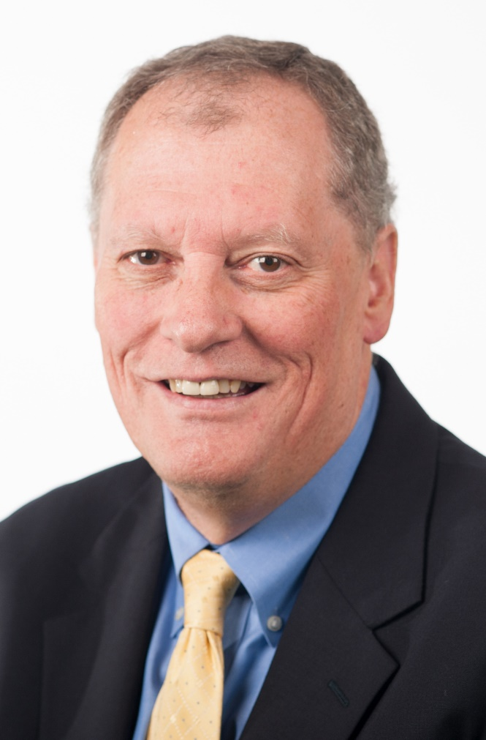
ABILITY FACTORS
Working memory capacity – ability to focus attention on task-relevant information.
Randy Engle, Georgia Tech

Slide 68
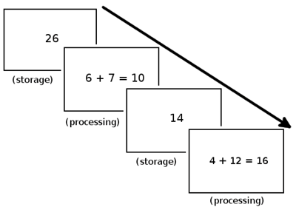
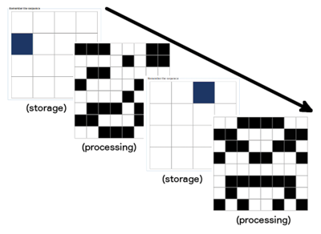
ABILITY FACTORS

Slide 69
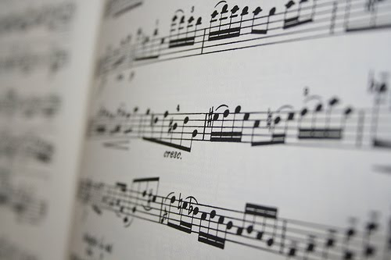
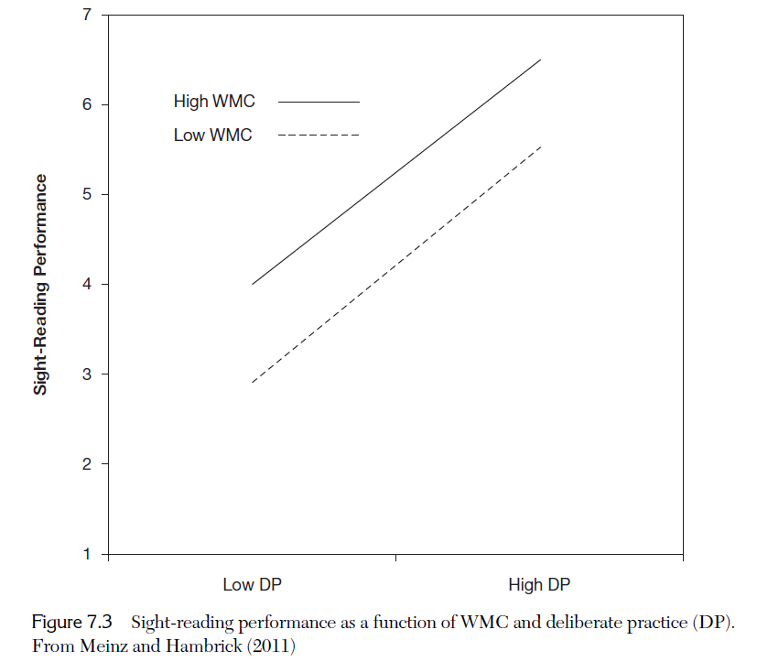
ABILITY FACTORS
Sight-Reading Performance
No WMC × DP interaction
Pianists performed…
Complex span tasks
Deliberate practice survey
Sight-reading task
Low
High
Deliberate Practice
Meinz & Hambrick (2010)

Slide 70
ABILITY FACTORS
Ability
Performance
Knowledge /Skill
How might ability factors be involved in expertise?

Slide 71
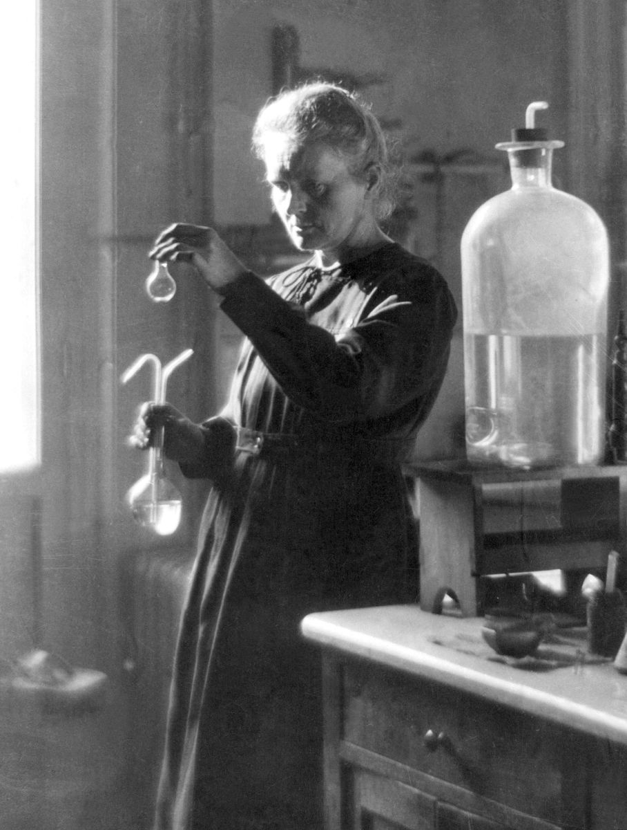
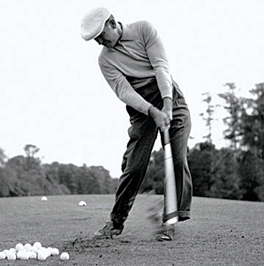
DISPOSITIONAL FACTORS
Ben Hogan: Hit practice balls until his hands bled, then soaked them in pickle brine to toughen skin.
Marie Cure: Often worked in her lab past midnight—after winning her first Nobel prize.

Slide 72

DISPOSITIONAL FACTORS
They have a powerful interest in the area, or domain, in which they have high ability —mathematics, say, or art—and they can readily focus so intently on work in this domain that they lose sense of the outside world.”
− Winner (1998)
“

Slide 73
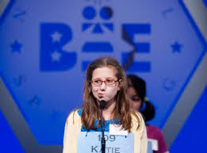
DISPOSITIONAL FACTORS
.31
Deliberate Practice
.38
Spelling Performance
Grit (C?)
Duckworth, Kirby, Tsukayama, Berstein, & Ericsson (2011)

Slide 74
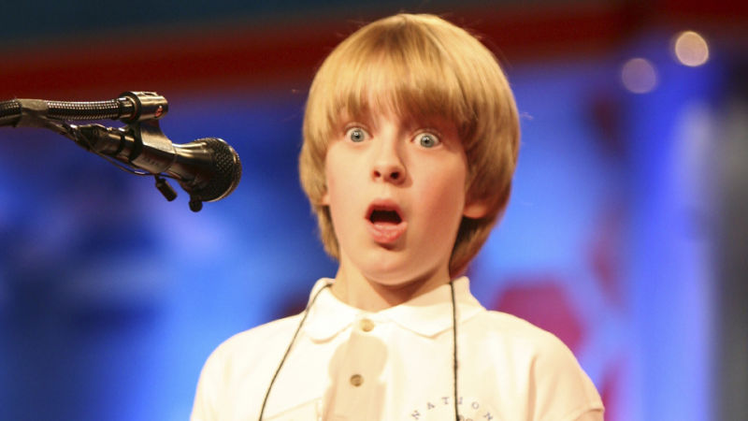
DISPOSITIONAL FACTORS
Other dispositional factors could have a direct effect…
Emotional Regulation
.31
Deliberate Practice
.38
Spelling Performance
Grit (C?)
Duckworth, Kirby, Tsukayama, Berstein, & Ericsson (2011)

Slide 75

DISPOSITIONAL FACTORS

Slide 76


GENETIC FACTORS

Slide 77
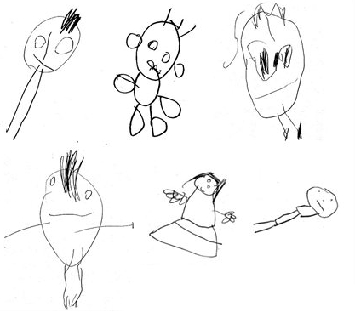
GENETIC FACTORS
Arden et al. (2014) −
7,752 twins complete Draw-A-Person Test and test of general intelligence at age 4, and the latter again at age 10.

Slide 78
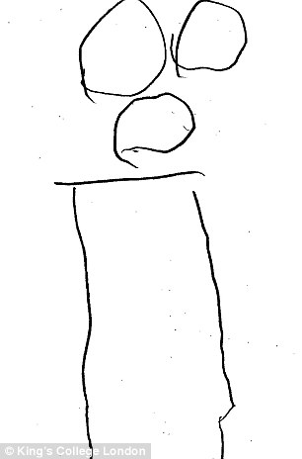
GENETIC FACTORS
Score from 0 – 12, based on presence and correct number of features (e.g., head, eyes, nose, mouth)

Slide 79

GENETIC FACTORS

Slide 80
GENETIC FACTORS
r = .55
r = .39

Slide 81
GENETIC FACTORS
32%
r = .55
r = .39

Slide 82

GENETIC FACTORS
- Data from National Merit Twin Study of 1962
- 800 twin pairs identified from 400k high school juniors
- Large survey of interests, attitudes, preferences, accomplishments, etc.
- Heritability of .26 for music accomplishment and .38 for music practice

Slide 83

GENETIC FACTORS

Slide 84

TASK/SITUATIONAL FACTORS
Freemantle vs. Collingwood, AFWL, Optus Stadium, 10th February, 41,975 in attendance

Slide 85

TASK/SITUATIONAL FACTORS
Amabile (1979)
Subjects perform simple art task, creating a collage conveying a theme of “silliness”
Half told that work would be evaluated by panel of artists, other half not

Slide 86
TASK/SITUATIONAL FACTORS
Creativity Composite Score
Evaluation Expectation
Amabile (1979), J. of Personality and Social Psychology

Slide 87

WHERE FROM HERE?
  Develop multifactorial models of expertise that take into account all potentially relevant explanatory constructs.

Slide 88


TOWARD A MULTIFACTORIAL MODEL
Fredrik Ullén
Miriam Mosing
Ullén, Hambrick, & Mosing (2015, Psychological Bulletin)

Slide 89

ULLÉN ET AL. MGIM
Multifactorial Gene-Environment Interaction Model (MGIM)

Slide 90

ADVANCING THE SCIENCE
it is extremely likely that environmental factors, including deliberate practice, account for far more variance in performance than does innate capacity in every salient talent domain. Even so, psychology must endeavor to identify all of the significant causal factors behind exceptional performance rather than merely rest content with whatever factor happens to account for the most variance.”
− Simonton (1999)
“
Dean Simonton, UC Davis

Slide 91
TAKE-HOME MESSAGES
Is it necessary to train to develop expertise in an activity such as playing music or a sport?
Obviously! It’s the only way to acquire expertise.
Should I train if I want to develop expertise in such a domain?
Of course! You may improve more than you think possible.
Should I try to practice “deliberately” by seeking out the best possible approach to training.
    Absolutely! Whatever the domain, some ways of training will be better than others.

Slide 92
TAKE-HOME MESSAGES
BUT…

Slide 93

TAKE-HOME MESSAGES

Slide 94
ACKNOWLEDGEMENTS
Guillermo Campitelli Edith Cowan University
Fredrik Ullén Karolinska Institute
Miriam Mosing Karolinska Institute
Brooke Macnamara Case Western Reserve University
David Moreau University of Auckland
Erik Altmann Michigan State University
Alex Burgoyne Michigan State University
Fernand Gobet Liverpool University
Betsy Meinz Southern Illinois University E’ville
Fred Oswald Rice University

Slide 95

www.scienceofexpertise.com

Slide 96

Now accepting submissions!
www.journalofexpertise.org

Slide 97
EXTRA SLIDES

Slide 98
CAVEATS
Ericsson (2006), Figure 38.4
(1) Case for deliberate practice is based largely on cross-sectional evidence.

Slide 99




CAVEATS
(2) Case for deliberate practice is based largely on self-reports of practice.

Slide 100
Deliberate Practice View
Multiple Determinants
Hypothesis
Strong Hypothesis
Weak Hypothesis
1%
< 50%
< 50%
> 50%
> 50%
99%
Deliberate practice accounts for virtually all of the reliable variance in expertise
Deliberate practice accounts for the majority (> 50%) of the reliable variance in expertise
Deliberate practice accounts for a significant proportion (< 50%) of the reliable variance in expertise
Deliberate practice
Other

Slide 101
ERICSSON’S RESPONSE
In an unpublished commentary on Macnamara, Hambrick, and Oswald (2014) meta-analysis, Ericsson (2014) claimed that only 1 of 88 studies included in meta-analysis met his criteria for accurately estimating the relationship between deliberate practice and performance.
PROBLEM: He rejected studies that he has used in the past to explicitly argue for the importance of “deliberate practice”—including 6 of his own studies.

Slide 102
ERICSSON’S RESPONSE
Studies that Ericsson (2014) rejects as invalid for our meta-analysis but previously used to argue for importance of “deliberate practice”:
1) Charness, Tuffiash, Krampe, Reingold, & Vasyukova (2005)
2) de Bruin, Rikers, & Schmidt (2007)
3) Duckworth, Kirby, Tsukayama, Berstein, & Ericsson (2011)
4) Duffy, Baluch, & Ericsson (2004)
5) Ericsson, Krampe, & Tesch-Römer (1993) - Study 1
6) Harris (2008) (dissertation supervised by Ericsson)
7) Helsen, Strakes, & Hodges (1998)
8) Hodges & Starkes (1996)
9) Hodges, Kerr, Starkes, Weir, & Nananidou (2004)
10) Hutchinson, Sachs-Ericsson, & Ericsson (2013)
11) Krampe & Ericsson (1993), Study 1 and 2
12) Sloboda (1996)
13) Sonnentag & Kleine (2001)
14) Starkes et al. (1996)
15) Tuffiash, Roring, & Ericsson (2007)
16) Ward, Hodges, Williams, & Starkes (2004)
17) Young (1998); Young et al. (2008) (cited in Starkes et al.)

Slide 103
ERICSSON’S RESPONSE
Example 1: Duffy, Baluch, & Ericsson (2004)
Ericsson (2014) rejects this study—
one of his own—because there is no record of a teacher/coach supervising all or most of practice, but earlier, he and his colleagues stated:
This finding supports one of the main tenets of Ericsson et al.’s (1993) theory whereby expertise is acquired through a vast number of hours spent engaging in activities purely designed to improve performance, i.e., deliberate
practice.” (p. 243)
- Duffy, Baluch, & Ericsson (2004)
“

Slide 104
ERICSSON’S RESPONSE
Example 2: Charness et al. (2005)
Ericsson (2014) rejects this study for same reason as previous example, but earlier, he stated:
“
This paper reports the most compelling and detailed evidence for how designed training (deliberate practice) is the crucial factor in developing expert chess performance.”
- Ericsson (2005, p. 237)

Slide 105
ERICSSON’S RESPONSE
Recently, Ericsson and colleagues (Ericsson & Pool, 2016; Moxley, Ericsson, & Tuffiash, 2017) introduced distinction between self-directed “purposeful practice” and teacher-led “deliberate practice.” Potentially useful distinction, but…
PROBLEM: Ericsson and colleagues have recast previous studies that they have used to argue for important of “deliberate practice” as studies of “purposeful practice”—without explicitly acknowledging the shift in terms.
Examples…

Slide 106
ERICSSON’S RESPONSE
“Several researchers have reported a consistent association between the amount and quality of solitary activities meeting the criteria of deliberate practice and performance in different domains of expertise, such as…Scrabble” (p. 9).
- Ericsson et al. (2009)
“[T]he domain of SCRABBLE is a recently developed domain, and it lacks professional coaches and a large body of written knowledge about training. SCRABBLE players, therefore, must decide for themselves which types of training activities that they think are effective for
improving their performance. Consequently, SCRABBLE players cannot engage in deliberate practice, but only purposeful practice and other types of practice.”
- Moxley, Tuffiash, & Ericsson (2017)

Slide 107
ERICSSON’S RESPONSE
On Spelling Bee study by Duckworth, Kirby, Tsukayama, Berstein, & Ericsson (2011):
“In that study we (as I was also one of the co-authors) collected data on ‘deliberate practice.’”
- Ericsson (2012)
Consistent with this characterization, “deliberate practice” appears 60+ times throughout the article, and a measure is labeled “deliberate practice.” Yet, 5 years later, commenting on same Spelling Bee study after distinguishing between “purposeful practice” and “deliberate practice”:
“After the questionnaire, we asked participants to fill out several additional personality measures that Duckworth et al. (2011) had found to be related to purposeful practice in preparation for competitions in spelling…”
- Moxley, Tuffiash, & Ericsson (2017)

Slide 108

Using studies to argue for a theory, then rejecting those studies…

Slide 109

WHAT MAKES A THEORY SCIENTIFIC?
“In so far as a scientific statement speaks about reality, it must be falsifiable”
- Karl Popper, The Logic of Scientific Discovery

